Slide 1
Flexible AC Transmission Systems Parallel Compensation – SVC and STATCOM Technology, Benefits, Applications
Transmission Solutions

Slide 2
Parallel Compensation Solutions Portfolio
Response: 2-5 cycles
Limited switching
Response: seconds
SVC PLUS
(STATCOM)
MSC / MSR
Synchronous Condenser
Conventional SVC
(“Classic”)
Mechanically Switched
Capacitors / Reactors
Static Var
Compensator
Static Synchronous
Compensator
Switchgear
Generator
Thyristor Valve(s)
IGBT Valves (VSC)
Capacitors
Control & Protection
Control & Protection
Control & Protection
Reactors
Transformer
Transformer
Transformer
Capacitors
DC Capacitors
Reactors
Response: 2-3 cycles
Unlimited switching
Response: 1.5-2 cycles
Unlimited switching
20 ≤ MVAr ≤ 400
25 ≤ MVAr ≤ 1000
± 50 ≤ MVAr ≤ ± 1000
±25 ≤ MVAr ≤ ±500
~
~
~
~
~

Slide 3
VSC Operating Principles
Electric Model
U_{N} : Network Voltage
U_{C}: Converter Voltage
U_{L}: Reactor Voltage
I_{L}: Reactor or
Converter Current
U_{L}
I_{L}
U_{N}
U_{C}

Slide 4
Advantages SVC PLUS
Compared to 2/3-Level VSC Technology
Lower Losses (lower switching frequency)
Longer life time of electronic components (lower stresses)
Lower Harmonic generation (Multilevel technology)
Lower space requirements

Slide 5
SVC Design
Typical Configuration
2
1
Transformer
Arrestor
TCR (Thyristor Controlled Reactor) branch
TSC (Thyristor Switched Capacitor) capacitor
TSC reactor
TSC Valve + arrester
Filter branch
1
2
3
2
5
7
4
5
3
6
6
7
4

Slide 6
SVC Classic V / I characteristic

Slide 7
SVC PLUS V / I characteristic

Slide 8
SVC PLUS vs. SVC Classic V / I characteristic

Slide 9
Benefits of SVC PLUS compared to SVC Classic
Summary
SVC PLUS design practically independent on network conditions
Low harmonic generation
Improved under voltage performance
High transient overload capability
Low noise contribution
Small space requirements
Easily expandable

Slide 10
SVC PLUS Portfolio
Containerized Solution
SVC PLUS S: +/- 25 MVAr
SVC PLUS M: +/- 35 MVAr
SVC PLUS L: +/- 50 MVAr
Up to 4 equal units in parallel max +/-200MVAr
Open Rack Solution (installed in a building)
SVC PLUS C: +/-75 MVAr
SVC PLUS C: +/-100 MVAr
SVC PLUS C: +/-125 MVAr
Up to 4 equal units in parallel max. +/-500MVAr
Hybrid Solutions
SVC PLUS C with external devices and/or thyristor switched branch(es)

Slide 11
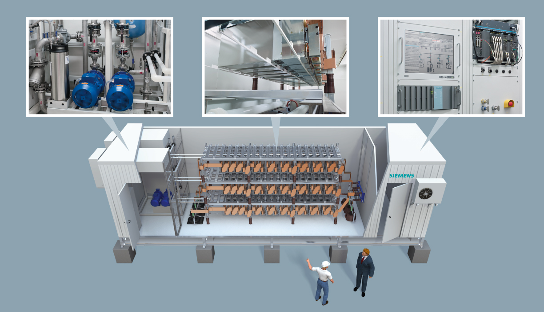
SVC PLUS in Detail Insight view
Cooling system Converter Control & Protection

Slide 12
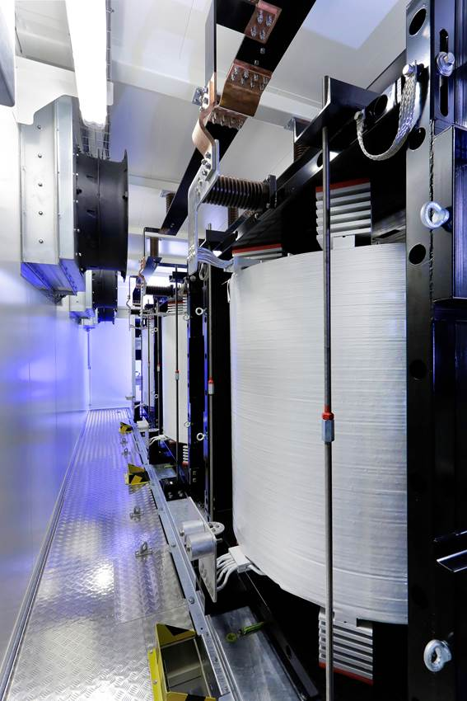
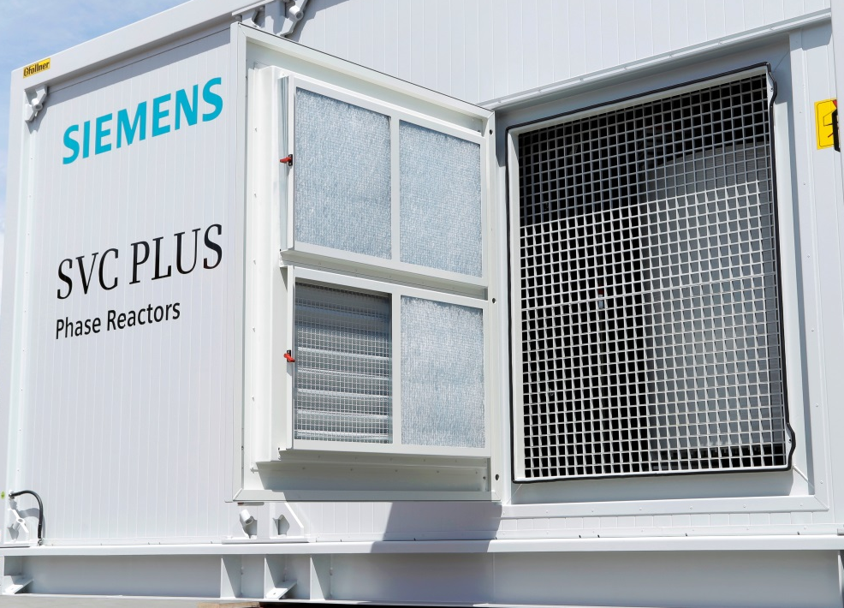
SVC PLUS Containerized Phase Reactors
Benefits
Includes all relevant busbars, CT / VT and disconnector
reduced civil works & installation efforts
reduced installation time
lower noise emission
compact footprint with reduced space requirements
protection against environmental influences

Slide 13
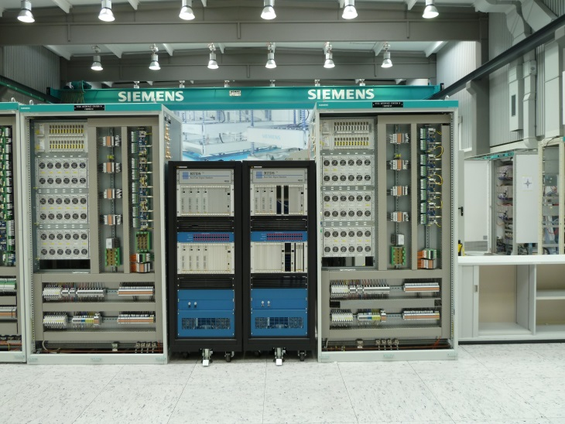
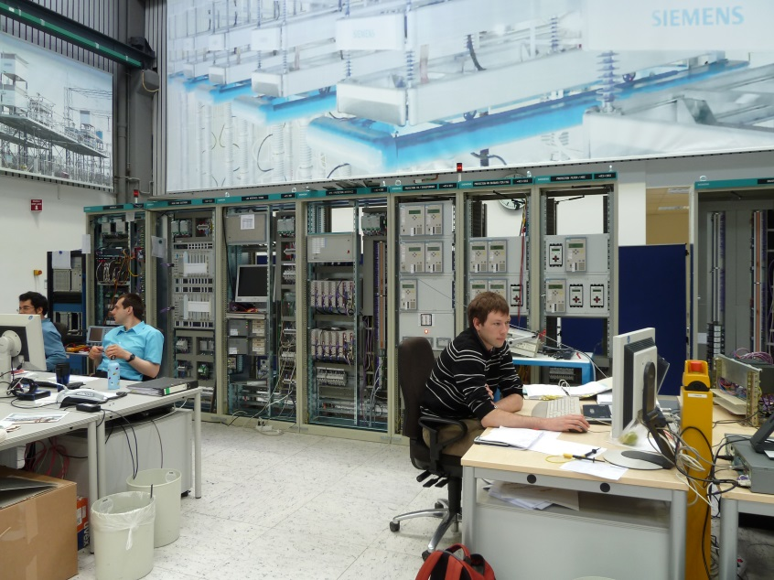
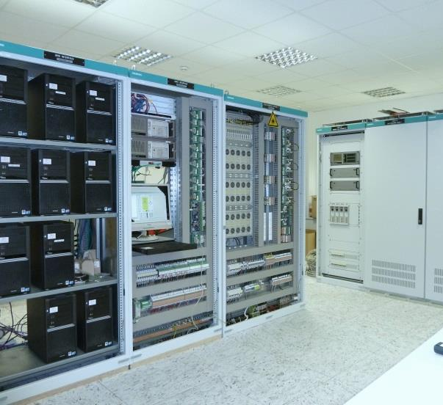
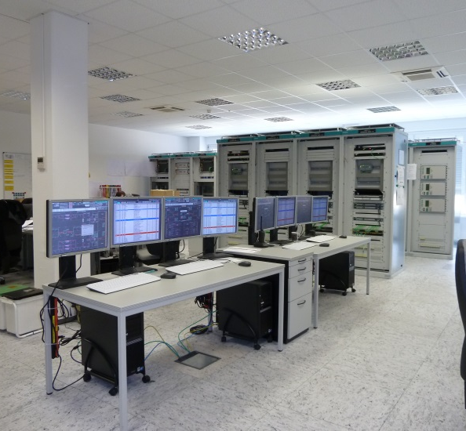
Manufacturing and Factory Tests Functional & Dynamic Performance Test Center
The functional and dynamic performance test is an integral part of Siemens‘ project execution and testing philosophy.
You as a customer are always welcome to participate.
Notes:
Memo 13
Functional Performance Tests
The complete HVDC control protection, operating and monitoring system including the interface cubicles are checked in a functional test. In this test all cubicles are connected together using the same prefabricated cables that will be used on site.

Slide 14
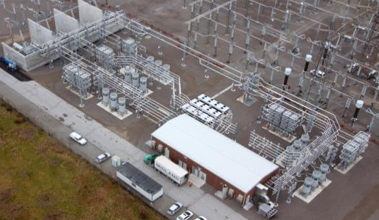
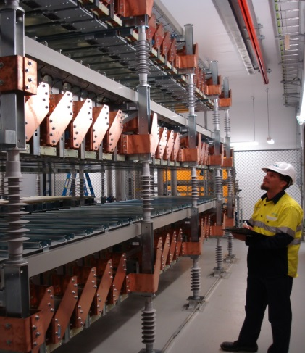
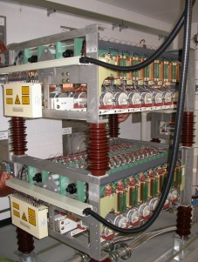
Hybrid SVC The continuous innovation of the SVC
SVC Classic - 1970’s
SVC PLUS - 2008
Hybrid SVC - 2011
Hybrid SVC is the logical progression of available technologies by combining both, VSC and thyristor based technology
All SVC PLUS advantages are used and thyristor switched branches allow extension to unsymmetrical operating range

Slide 15
Hybrid SVC Features of Hybrid SVC
Main Reasons for Hybrid SVC
Customized operating range
SVC PLUS has symmetric operating range. Additionally a TSC or TSR will be installed to extend the range to a customized operating range.
Make full use of SVC PLUS Advantages
Combining the VSC Technology with the Thyristor Technology brings all the advantages of the SVC PLUS into the solution
Reduce the Complexity of the Solution
For big operating range the Hybrid SVC will reduce the complexity of the offered solution compared to SVC Classic solution

Slide 16
Hybrid SVC Single Line Diagram - 1x VSC + 1x TSC + 1x TSR
HV
MV
SVC PLUS
TSC
TSR

Slide 17
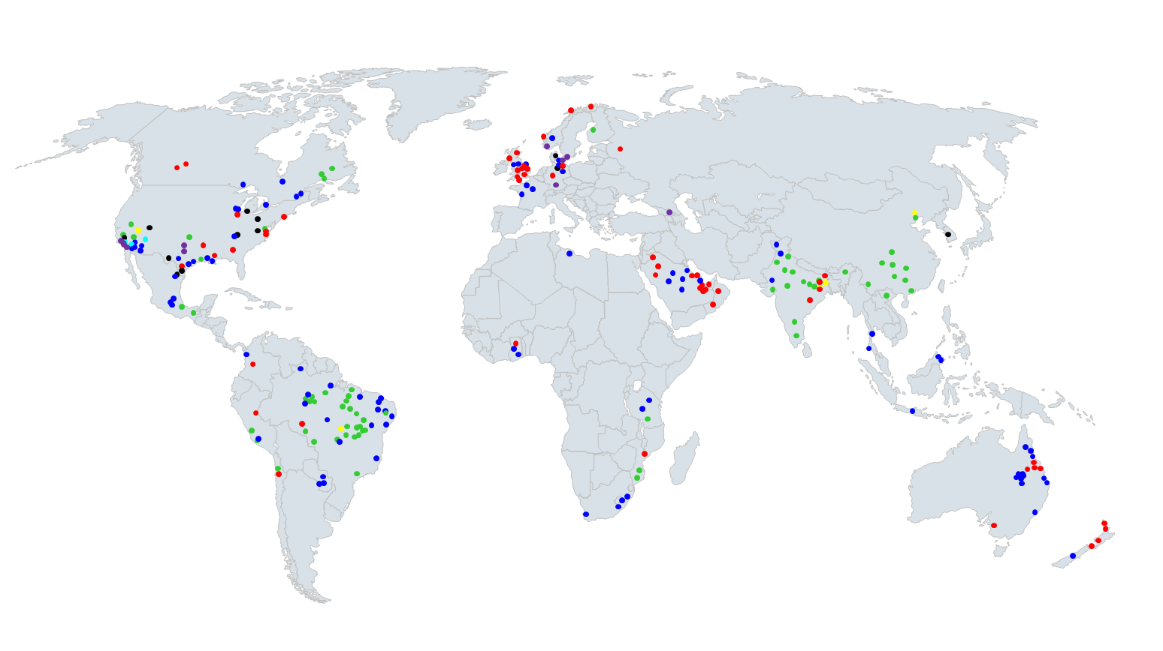
FACTS - worldwide
SVC –
SVC PLUS –
SynCon –
FSC –
TCSC –
TPSC –
Others –
Notes:
17

Slide 18
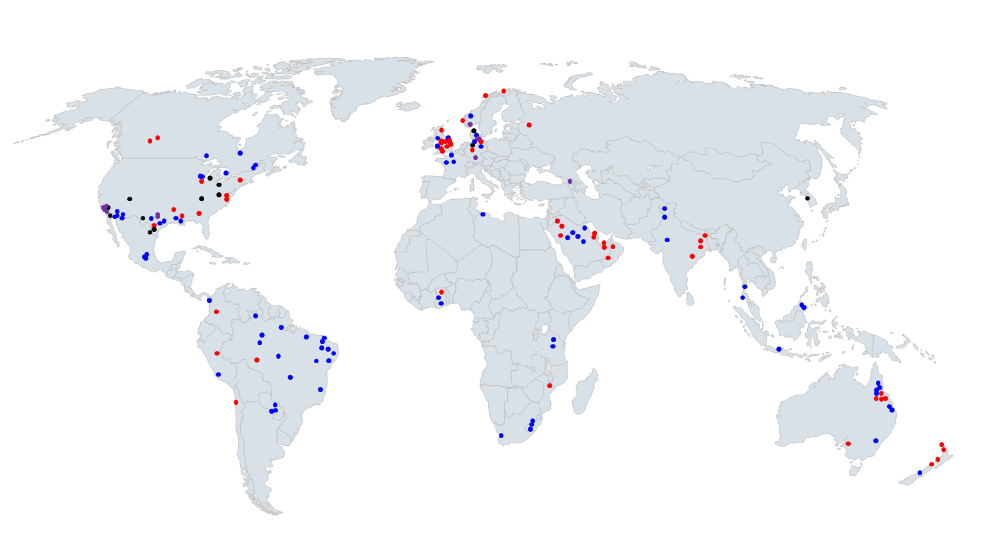
Parallel compensation - worldwide
SVC –
SVC PLUS –
SynCon –
Others –
Notes:
18

Slide 19
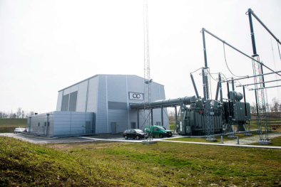
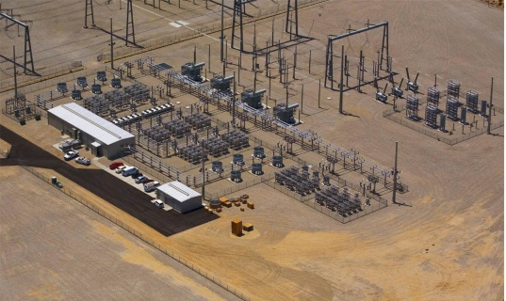
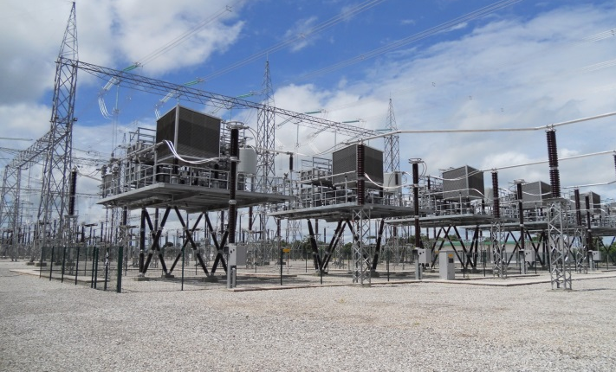
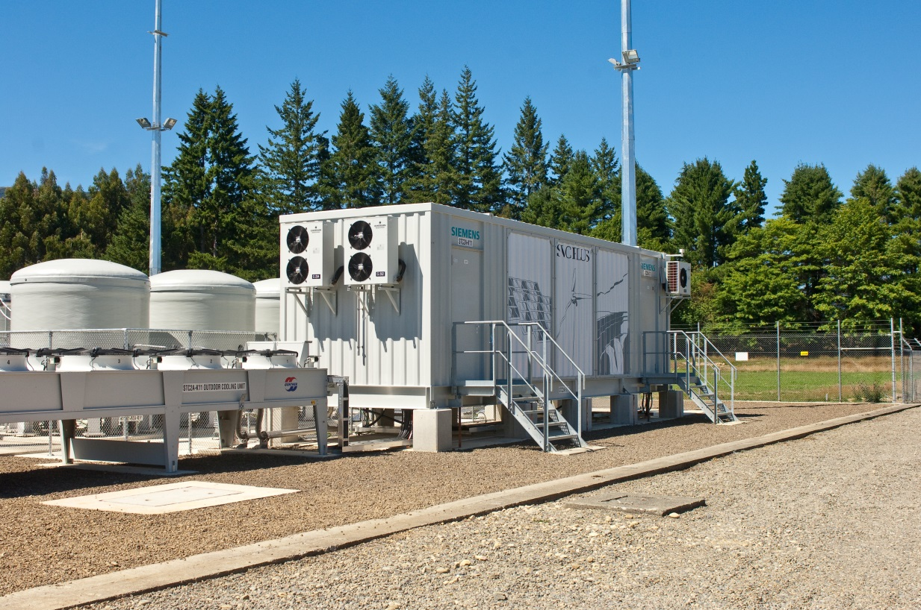
THANK YOU!
http://www.siemens.com

